Slide 1

Photo by Vanderlin - Creative Commons Attribution-NonCommercial-ShareAlike License https://www.flickr.com/photos/99141439@N00
Created with Haiku Deck

Slide 2

Photo by hjl - Creative Commons Attribution-NonCommercial License https://www.flickr.com/photos/92605333@N00
Created with Haiku Deck

Slide 3
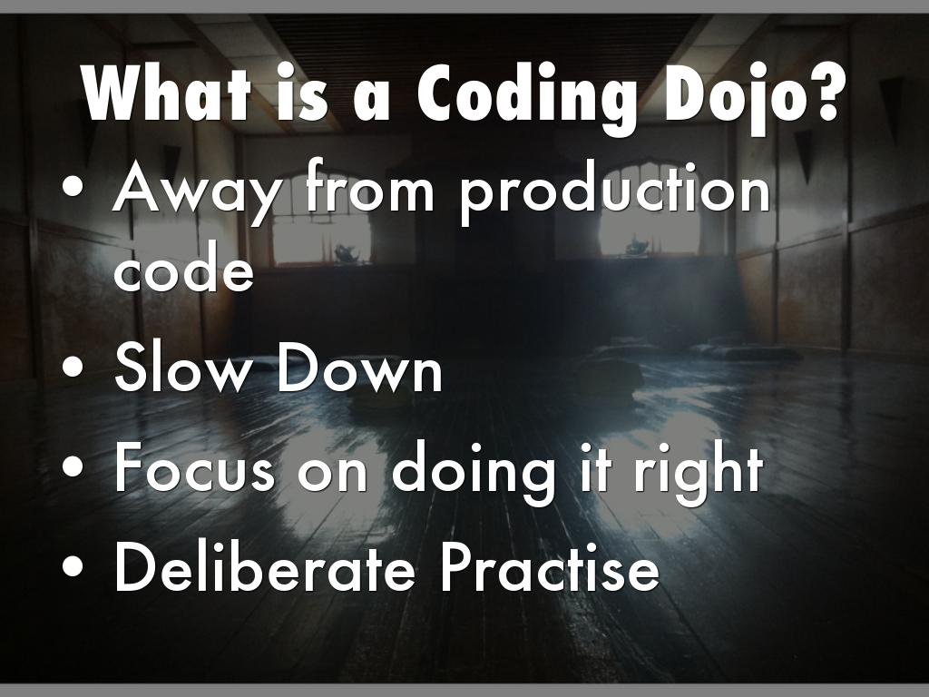
Photo by soaringbird - Creative Commons Attribution-ShareAlike License https://www.flickr.com/photos/36905388@N00
Created with Haiku Deck

Slide 4
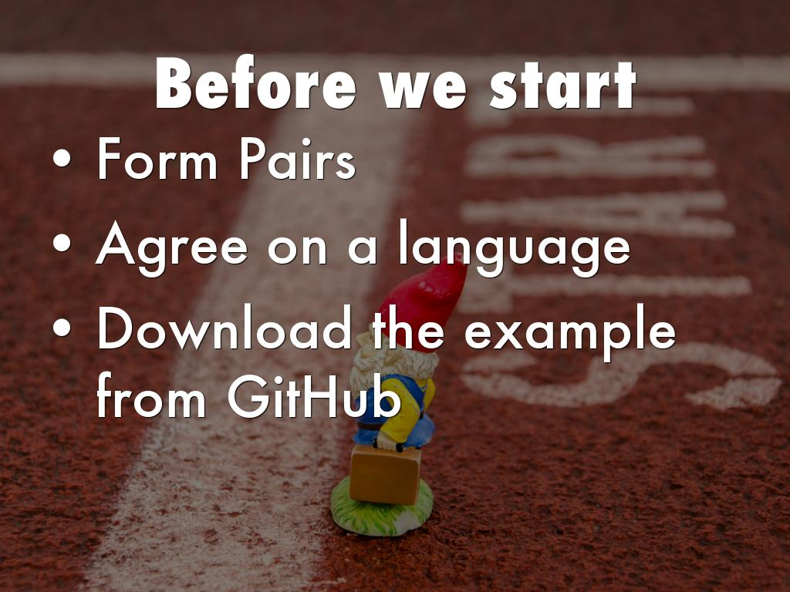
Photo by Rob Swatski - Creative Commons Attribution-NonCommercial License https://www.flickr.com/photos/50946274@N02
Created with Haiku Deck

Slide 5
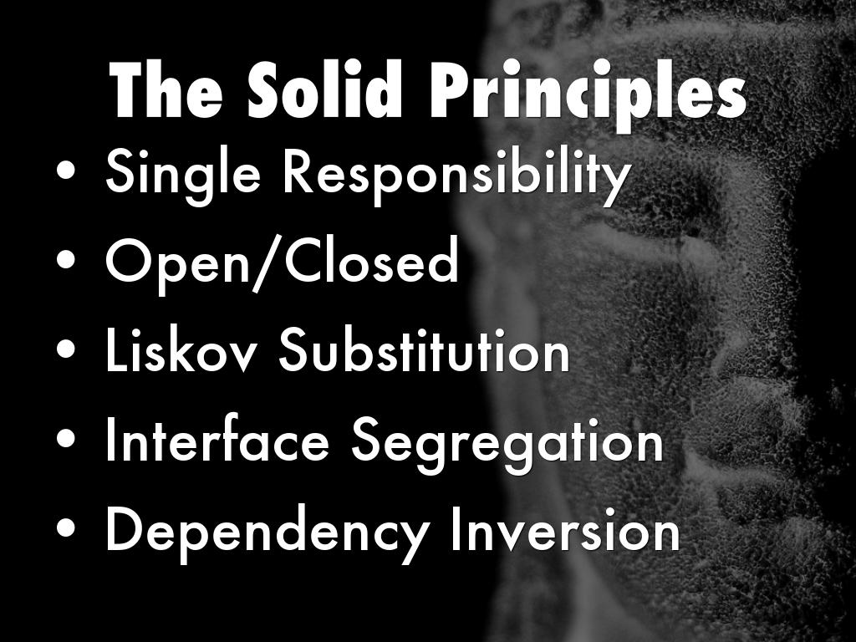
Photo by seanmcgrath - Creative Commons Attribution License https://www.flickr.com/photos/52798669@N00
Created with Haiku Deck

Slide 6
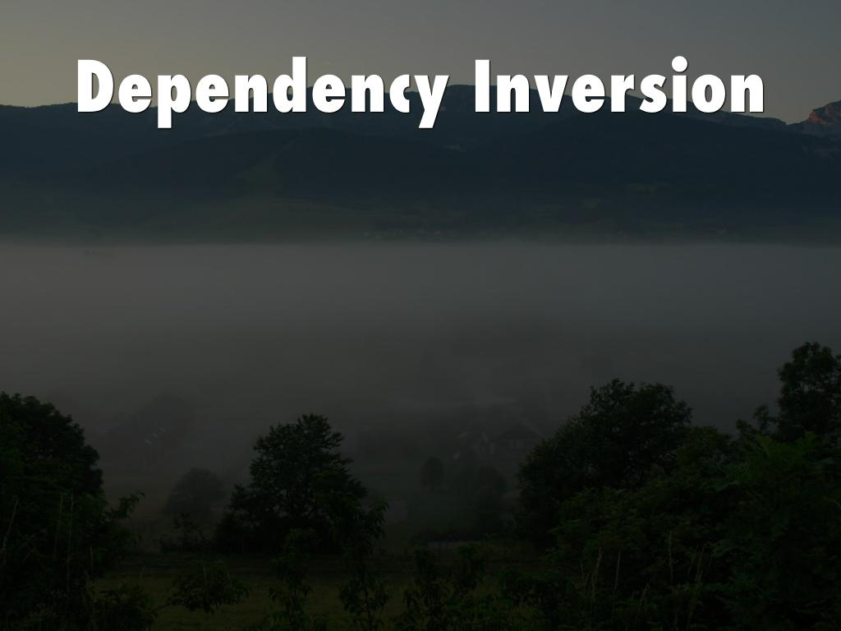
Photo by Mike Knell - Creative Commons Attribution-ShareAlike License https://www.flickr.com/photos/30523851@N00
Created with Haiku Deck

Slide 7
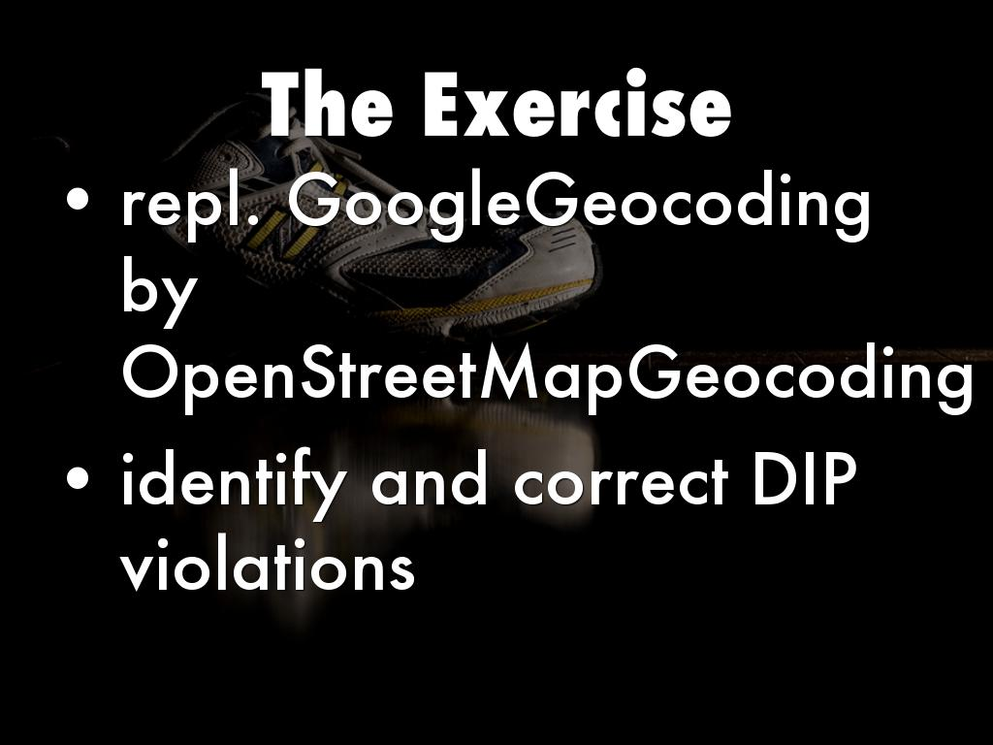
Photo by mrlins - Creative Commons Attribution-NonCommercial License https://www.flickr.com/photos/68467272@N00
Created with Haiku Deck

Slide 8
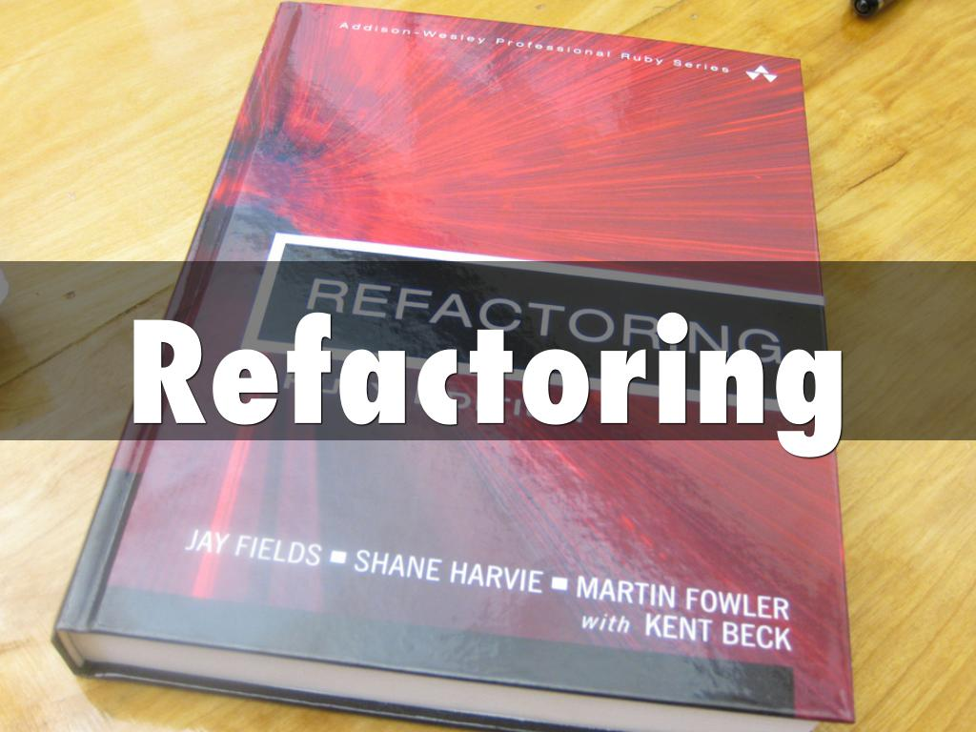
Photo by speric - Creative Commons Attribution-NonCommercial License https://www.flickr.com/photos/48615510@N00
Created with Haiku Deck

Slide 9

Photo by Richard Digimist - Creative Commons Attribution-NonCommercial License https://www.flickr.com/photos/30898814@N03
Created with Haiku Deck

Slide 10

Photo by Reuver - Creative Commons Attribution License https://www.flickr.com/photos/17739115@N00
Created with Haiku Deck

Slide 11
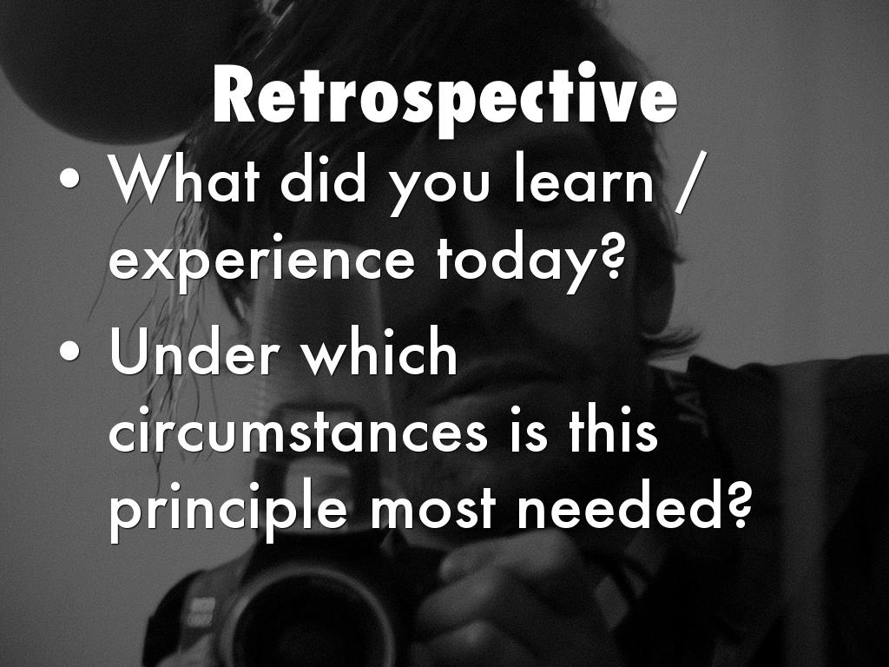
Photo by Jitter Buffer - Creative Commons Attribution-NonCommercial-ShareAlike License https://www.flickr.com/photos/93737034@N00
Created with Haiku Deck

Slide 12

Photo by vernhart - Creative Commons Attribution-NonCommercial-ShareAlike License https://www.flickr.com/photos/37183619@N00
Created with Haiku Deck

